Slide 1


Team Airborne
Giovanni Buonomo, Tate Finger, Quang Huynh

Slide 2
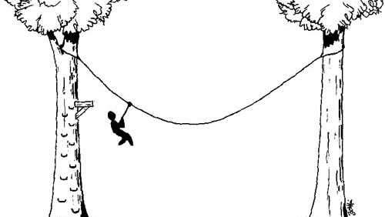
Goal
The goal of this project is to construct a project that can drop a washer into grade boxes while falling from a slanted zipline made out of a fishing line, without touching the project in any way.

Slide 3
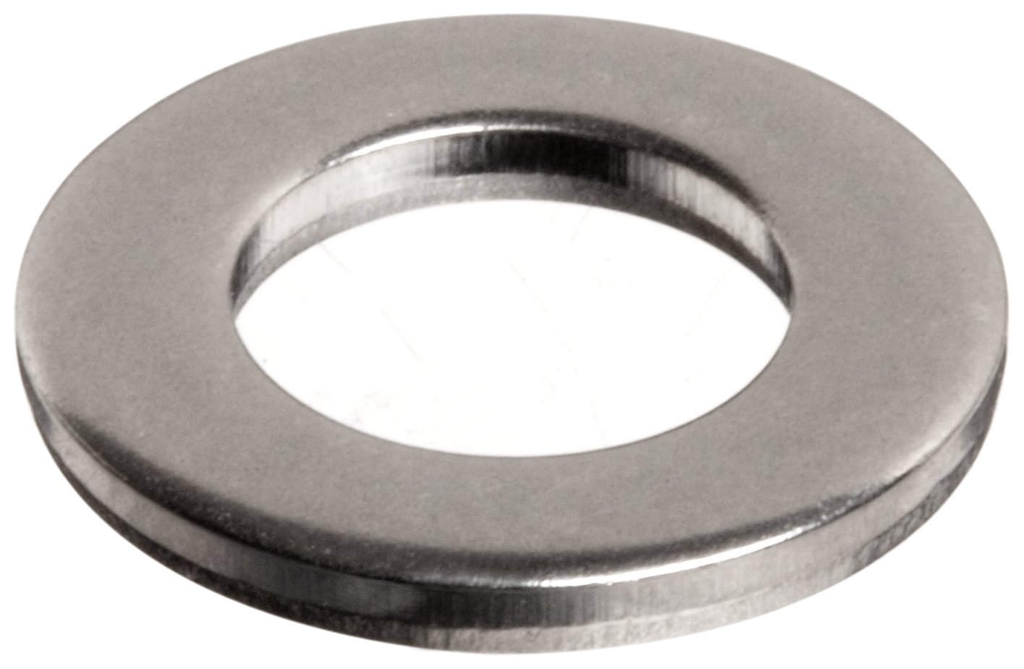
Procedure
Our project involves attaching the washer to a paperclip secured to the end of an elongated pole, consisting of rope, a straw, and a pipe cleaner. As the project is falling from the zipline, the length is predetermined to be at a length that would let the washer hit the backboard of the 100% grade box, letting the washer fall into the grade box. Our project goes at a deliberate speed, so it doesn’t get caught on one of the grade boxes.

Slide 4

Grade Prediction
Our project will get a 100, as it’s very consistent, and it is easily adjustable.

Slide 5
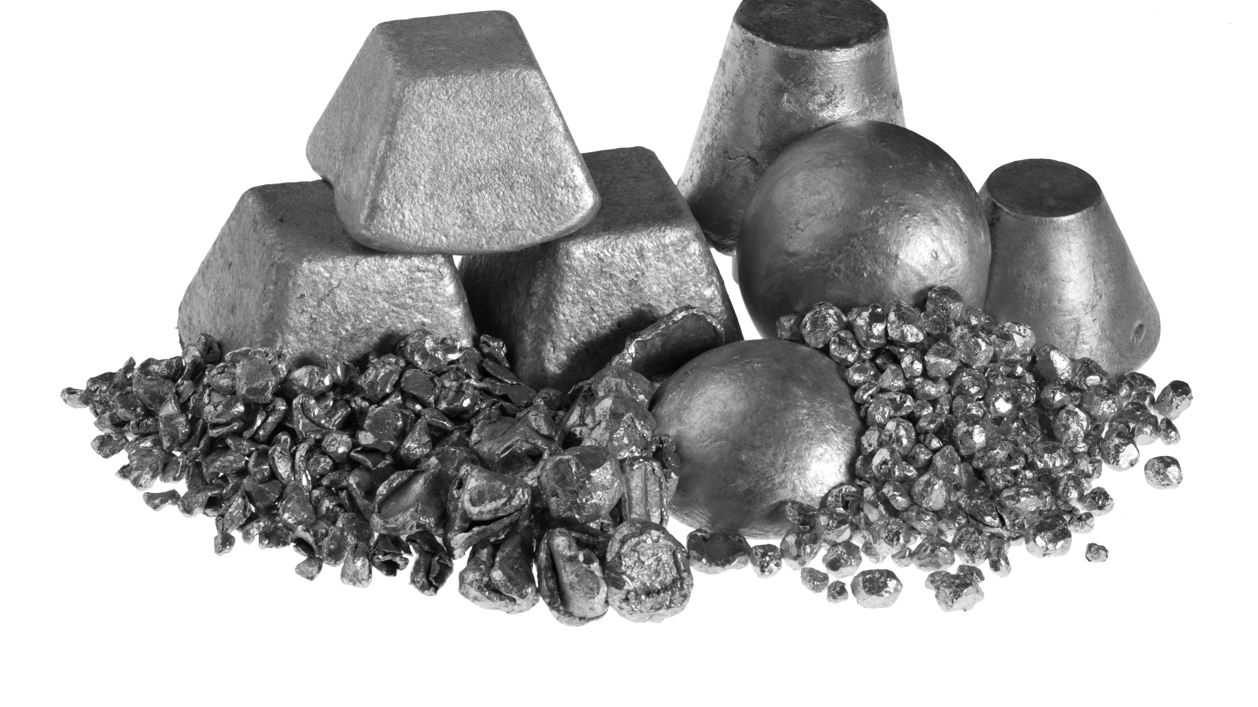
What We Could’ve Done Differently
Our group could’ve built the project using stronger materials.

